Slide 1

VLSI PROJECT
Design & Verification of
SPI Master-Slave Interface
Presented By: RAHUL D J
Verilog RTL development, testbench creation, and full-duplex waveform simulation.

Slide 2
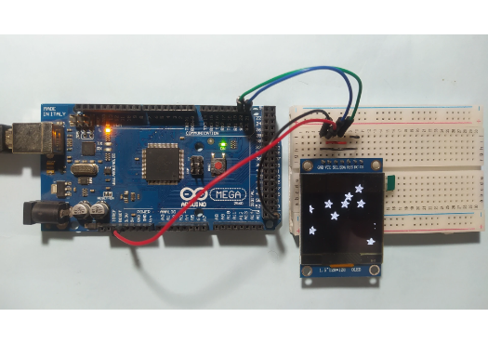
Why SPI? Real-World Applications
Serial Peripheral Interface (SPI) is the backbone of modern embedded systems.
▹
Microcontrollers: Almost all MCUs (like Arduino, ESP32, STM32) use SPI to talk to peripherals.
▹
Sensors: High-speed temperature, accelerometer, and gyro sensors rely on SPI for fast data readout without lag.
▹
OLED Displays: Because SPI is a fast, synchronous protocol, it is perfect for pushing pixel data to small screens rapidly.
▹
Simplicity: No complex addressing overhead—just pull the Chip Select line low and start the clock.

Slide 3









Project Objectives
1. RTL Development
2. Verification
3. Waveform Analysis
Develop robust Verilog RTL source code for both Master and Slave modules, ensuring reliable, synthesizeable state-machine design.
Create a comprehensive testbench to verify all major functionalities and ensure the logic holds up under simulated conditions.
Demonstrate successful full-duplex communication (simultaneous data transmission and reception) through rigorous waveform simulation.

Slide 4
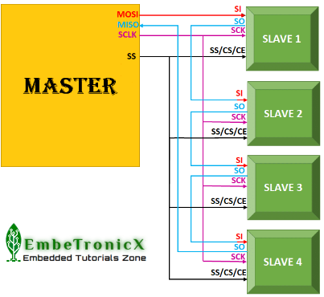
The Architecture (Mode 0)
We implemented SPI Mode 0 (CPOL=0, CPHA=0).
▹
SCLK (Clock): Generated by the Master. Idles LOW.
▹
MOSI & MISO: Data travels simultaneously on two wires for true full-duplex, high-throughput swapping.
▹
CS (Chip Select): Active-low signal that wakes up the Slave.
▹
Data Sampling: Because CPHA=0, data is sampled on the leading (rising) edge of the clock.

Slide 5


RTL Implementation Strategy
The Master Module
The Slave Module
Designed using a 2-state Moore Machine (IDLE and TRANSFER). The Master controls the entire transaction. Upon receiving a 'start' trigger, it pulls CS low, generates exactly 8 clock pulses, and shifts data out on MOSI while capturing data on MISO.
Designed as purely passive, reactive logic. It has no internal clock generator. It uses a shift register to instantly push its first bit onto MISO when CS drops low, and then shifts remaining bits on the falling edges of the Master's clock.

Slide 6
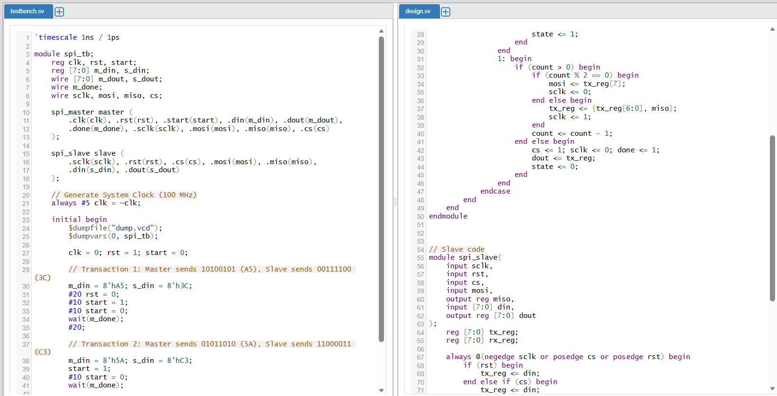
Coding Environment (EDA Playground)
▹
Both Master and Slave modules were compiled cleanly within a single `design.sv` file.
▹
Code was written utilizing non-blocking (`<=`) assignments inside sequential blocks to prevent race conditions during synthesis.
▹
The Testbench was loaded with specific hex data to track the swap: Master sends A5 and Slave sends 3C.

Slide 7
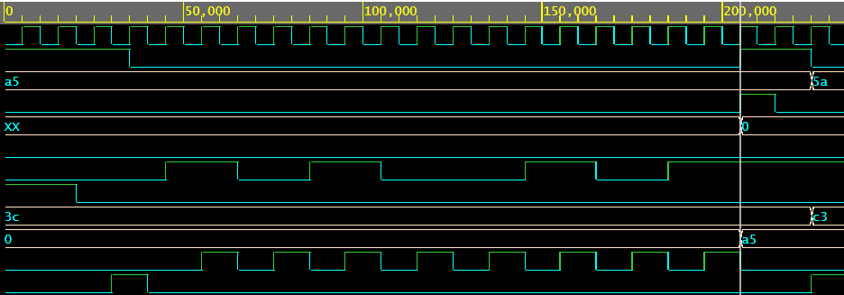
Verification: Catching a Bug
Simulations are critical for catching timing errors.
▹
The Issue: Notice how `miso` stays flat initially? The Master received `00` instead of `3c`.
▹
Root Cause: Mode 0 requires the Slave to have its first bit ready *before* the first clock edge. The initial RTL waited for a clock edge to shift.
▹
The Fix: The Slave logic was updated with continuous assignments to push the MSB onto MISO the exact instant `cs` drops low.

Slide 8
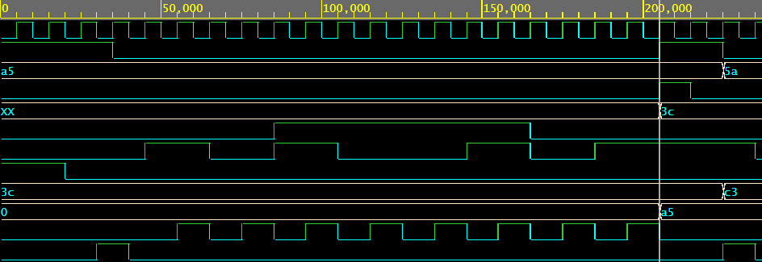
Final Result: 100% Full-Duplex
▹
Signals are ordered logically: Setup, Inputs, SPI Bus, Results.
▹
When `start` pulses, `cs` drops and `sclk` fires 8 times.
▹
Look at the green lines: `m_dout` successfully captures 3c and `s_dout` successfully captures a5.
▹
Data swap is mathematically perfect.

Slide 9
Project Deliverables Met
Verilog RTL Source Code: Clean, synthesizeable Master and Slave modules developed.
Proper Testbench: Created to inject specific Hex values and trigger transactions.
Verification & Debugging: Successfully identified and patched a Mode 0 timing bug.
Simulation Waveforms: Documented logical proof of full-duplex 8-bit data swapping.
Presentation & Understanding: Prepared to clearly explain logic, architecture, and results.

Slide 10
Questions?
Thank you for your time and evaluation.

